Slide 1
Introduction to Database(RDMS)

Slide 2
Definition of RDBM
A database management system (DBMS) that incorporates the relational-data model, normally including a Structured Query Language (SQL) application programming interface. It is a DBMS in which the database is organized and accessed according to the relationships between data items. In a relational database, relationships between data items are expressed by means of tables. Interdependencies among these tables are expressed by data values rather than by pointers. This allows a high degree of data independence.

Slide 3
MySQL
MySQL is an open-source relational database management system(RDBMS).Its name is a combination of "My", the name of co-founder Michael Widenius's daughter, and "SQL", the abbreviation for Structured Query Language. A relational database organizes data into one or more data tables in which data types may be related to each other; these relations help structure the data. SQL is a language programmers use to create, modify and extract data from the relational database, as well as control user access to the database.
Many of the world's largest and fastest-growing organizations including Facebook, Google, Adobe, Alcatel Lucent and Zappos rely on MySQL to save time and money powering their high-volume Web sites, business-critical systems and packaged software.

Slide 4
PostgreSQL
PostgreSQL features transactions with Atomicity, Consistency, Isolation, Durability (ACID) properties
It is designed to handle a range of workloads, from single machines to data warehouses or Web services with many concurrent users.
PostgreSQL comes with many features aimed to help developers build applications, administrators to protect data integrity and build fault-tolerant environments, and help you manage your data no matter how big or small the dataset. In addition to being free and open source, PostgreSQL is highly extensible. For example, you can define your own data types, build out custom functions, even write code from different programming languages without recompiling your database

Slide 5
SQL SERVER
Microsoft SQL Server is a relational database management system developed by Microsoft. As a database server, it is a software product with the primary function of storing and retrieving data as requested by other software applications which may run either on the same computer or on another computer across a network (including the Internet).
Similar to other RDBMS software, SQL Server is built on top of SQL, a standard programming language for interacting with the relational databases. SQL server is tied to Transact-SQL, or T-SQL, the Microsoft’s implementation of SQL that adds a set of proprietary programming constructs.
SQL Server works exclusively on Windows environment for more than 20 years. In 2016, Microsoft made it available on Linux. SQL Server 2017 became generally available in October 2016 that ran on both Windows and Linux.

Slide 6
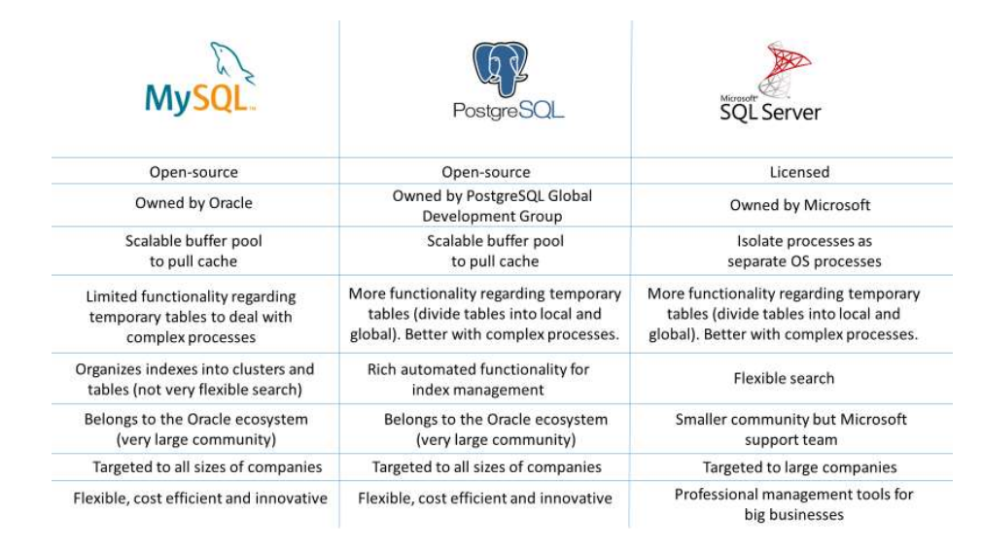
A comparison between the three RDBMS

